Slide 1
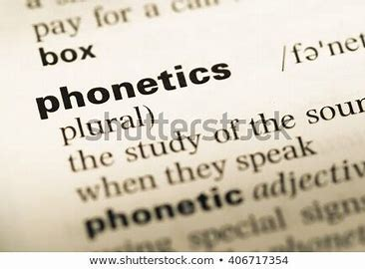
Phonetics
Prepared By:
ANINDITA GHOSH
Assistant Professor
Career Development Cell
Parul Institute of Technology

Slide 2

What is Phonetics?
Phonetics is a branch of linguistics that studies how humans make and perceive sounds, or in the case of sign languages, the equivalent aspects of sign.
Learning phonetics helps us improve our listening skills as we are taught to recognize words associated with the pronunciation.
Phonetics is a system of symbols used to represent all the sounds in English.

Slide 3
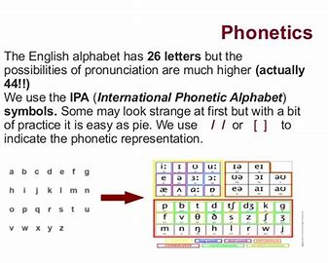

Slide 4
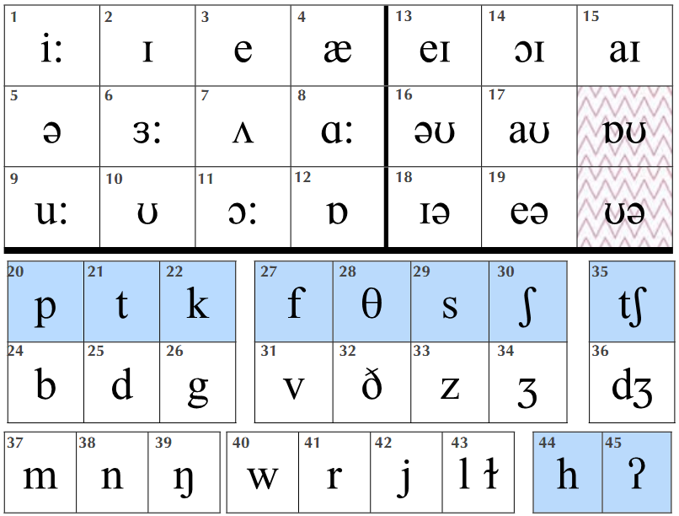
Phonetic Representation
Vowels | Consonants
1-12 Monothong 13-19 Diphthongs | 20 – 26 Plosives 27 – 34 Fricatives 35 – 36Affricatives 37 – 39 Nasals 40 – 43Approximants 44 – 45 Glottal

Slide 5

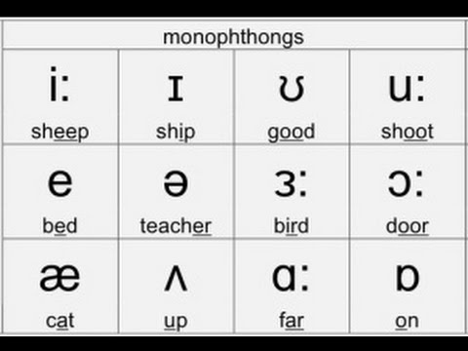
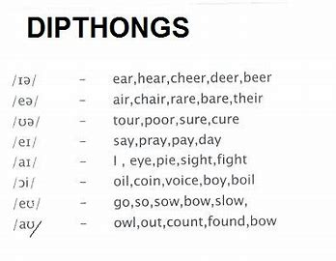
Vowel Sounds
1. Sounds in 1st image are monothongs: they require one mouth position.
2. Sounds in image 2nd, are diphthongs: they require two mouth positions.

Slide 6
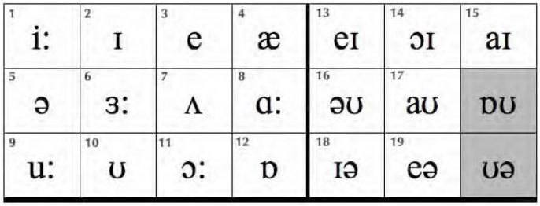
Vowel Sounds
3.Sounds /ɒʊ/ and /ʊ/ are common regional variations.
Sounds with / : / are long.

Slide 7
Sounds
Short Sounds | Long Sounds | Diphthong Sounds
ɪ =thin | i: =need | eɪ =pave
ʊ= look | u: = food | ɔɪ =boy
e =left | ɜ: =turn | aɪ =time
ʌ =love | ɑ: =heart | əʊ =road
æ =cat | ɔ: =bored | aʊ =down
ɒ= lost |  | ɪə =beard
 |  | eə =chair

Slide 8
Type of sound
Type of sound |  | sound |  | word-initial | word-final
PLOSIVE Air in the mouth followed by an explosion of air. |  | /p/ |  | park | Stop
 |  | /b/ |  | best | lob
 |  | /t/ |  | time | Might
 |  | /d/ |  | done | Paid
 |  | /k/ |  | cart | lake
 |  | /g/ |  | guide | Flag

Slide 9
FRICATIVE Denoting a type of consonant made by the friction of breath in a narrow opening, producing a turbulent air flow. |  | /f/ |  | fine | knife
 |  | /v/ |  | van | leave
 |  | /θ/ |  | think | path
 |  | /ð/ |  | those | bathe
 |  | /s/ |  | sort | pass
 |  | /z/ |  | zone | cheese
 |  | /ʃ/ |  | ship | marsh
 |  | /ʒ/ |  | - | measure

Slide 10
AFFRICATE A composite speech sound consisting of plosive followed by a fricative. |  | /tʃ/ |  | chart | itch
 |  | /dʒ/ |  | giant | page
NASAL Pronounced by the breath resonating in the nose |  | /m/ |  | main | lime
 |  | /n/ |  | no | rain
 |  | /ŋ/ |  | - | sing

Slide 11
APPROXIMANT In between a vowel and aconsonant, as the air is not fully blocked. |  | /w / |  | wall | -
 |  | /r/ |  | right | -
 |  | /j/ |  | yes | -
 | /l/ |  | /ɫ/ | like | fall
GLOTTAL |  | /h/ |  | hate | -
Produced in the glottis. |  | /ʔ/ |  | - | what

Slide 12
Decide if the words below are long (l), short (s) or diphthong (d) sounds. The first three have been done for you.
1. laughL | 2. hotS | 3. sideD | 4. chip | 5. moment
6. worn | 7. machine | 8. lose | 9. round | 10. west
11. cheers | 12. son | 13. book | 14. where | 15. are

Slide 13
Say the words and put them into their correct column(“S” sound and “Z” sound) in the box:
lease | plays lose | loose was lights | it’s peas | what’s crease
is us | please | pass as stop he’s | who’s | chase
.
s sound | z sound
lease | plays

Slide 14
The Schwa /ə/
The schwa is a very short, neutral vowel and most common sound in English. The exact quality of schwa sound depends on the consonants around it. It is found in virtually all English words with more than one syllable and it is the sound we use for the weak forms of many words.
E.g., earlier, cooker, painter, writer, teacher, soldier etc.,

Slide 15
The Schwa /ə/
The Schwa sound can replace any vowel sound in English.
Example- a, an, the, some, and, but, of, from, for, at, them, us, that, as, than, there, am, are, was etc.,
Try pronouncing the following words with the Schwa sound.
A, to, the, mirror, memory, data, bigger, between, other, pencil, about

Slide 16
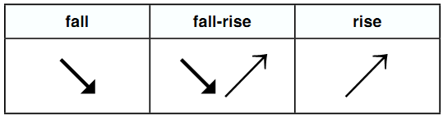
Intonation
Intonation is the movement in pitch of the voice. There are three intonation patterns in spoken English:
Example:
↘No (no) ↘↗No (maybe) ↗No (surprise)

Slide 17
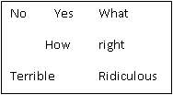
Repeat the words in the box:

Slide 18


